Slide 1

predicting post-operative length of stay
Using machine learning to improve care and improve utilization

Slide 2







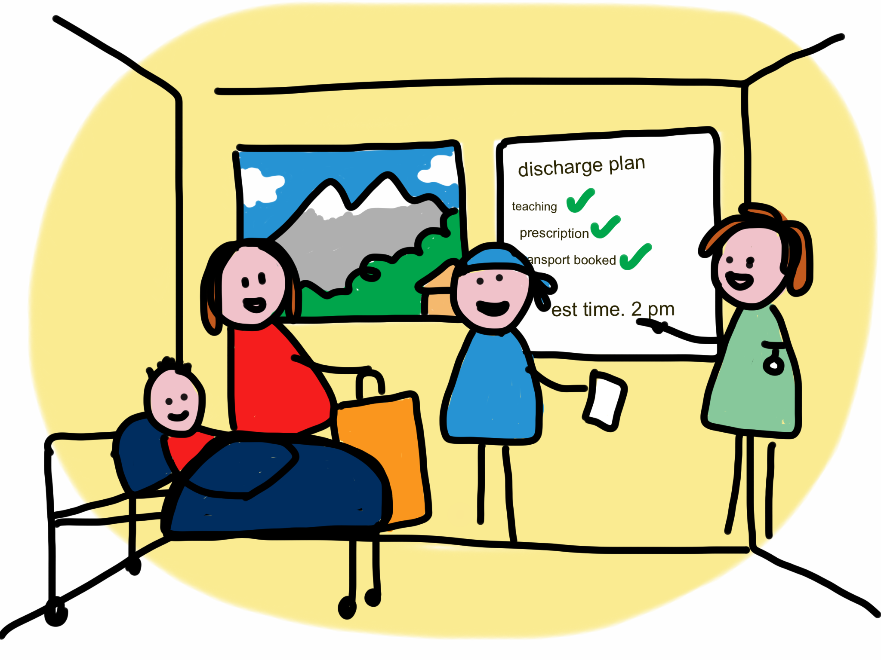


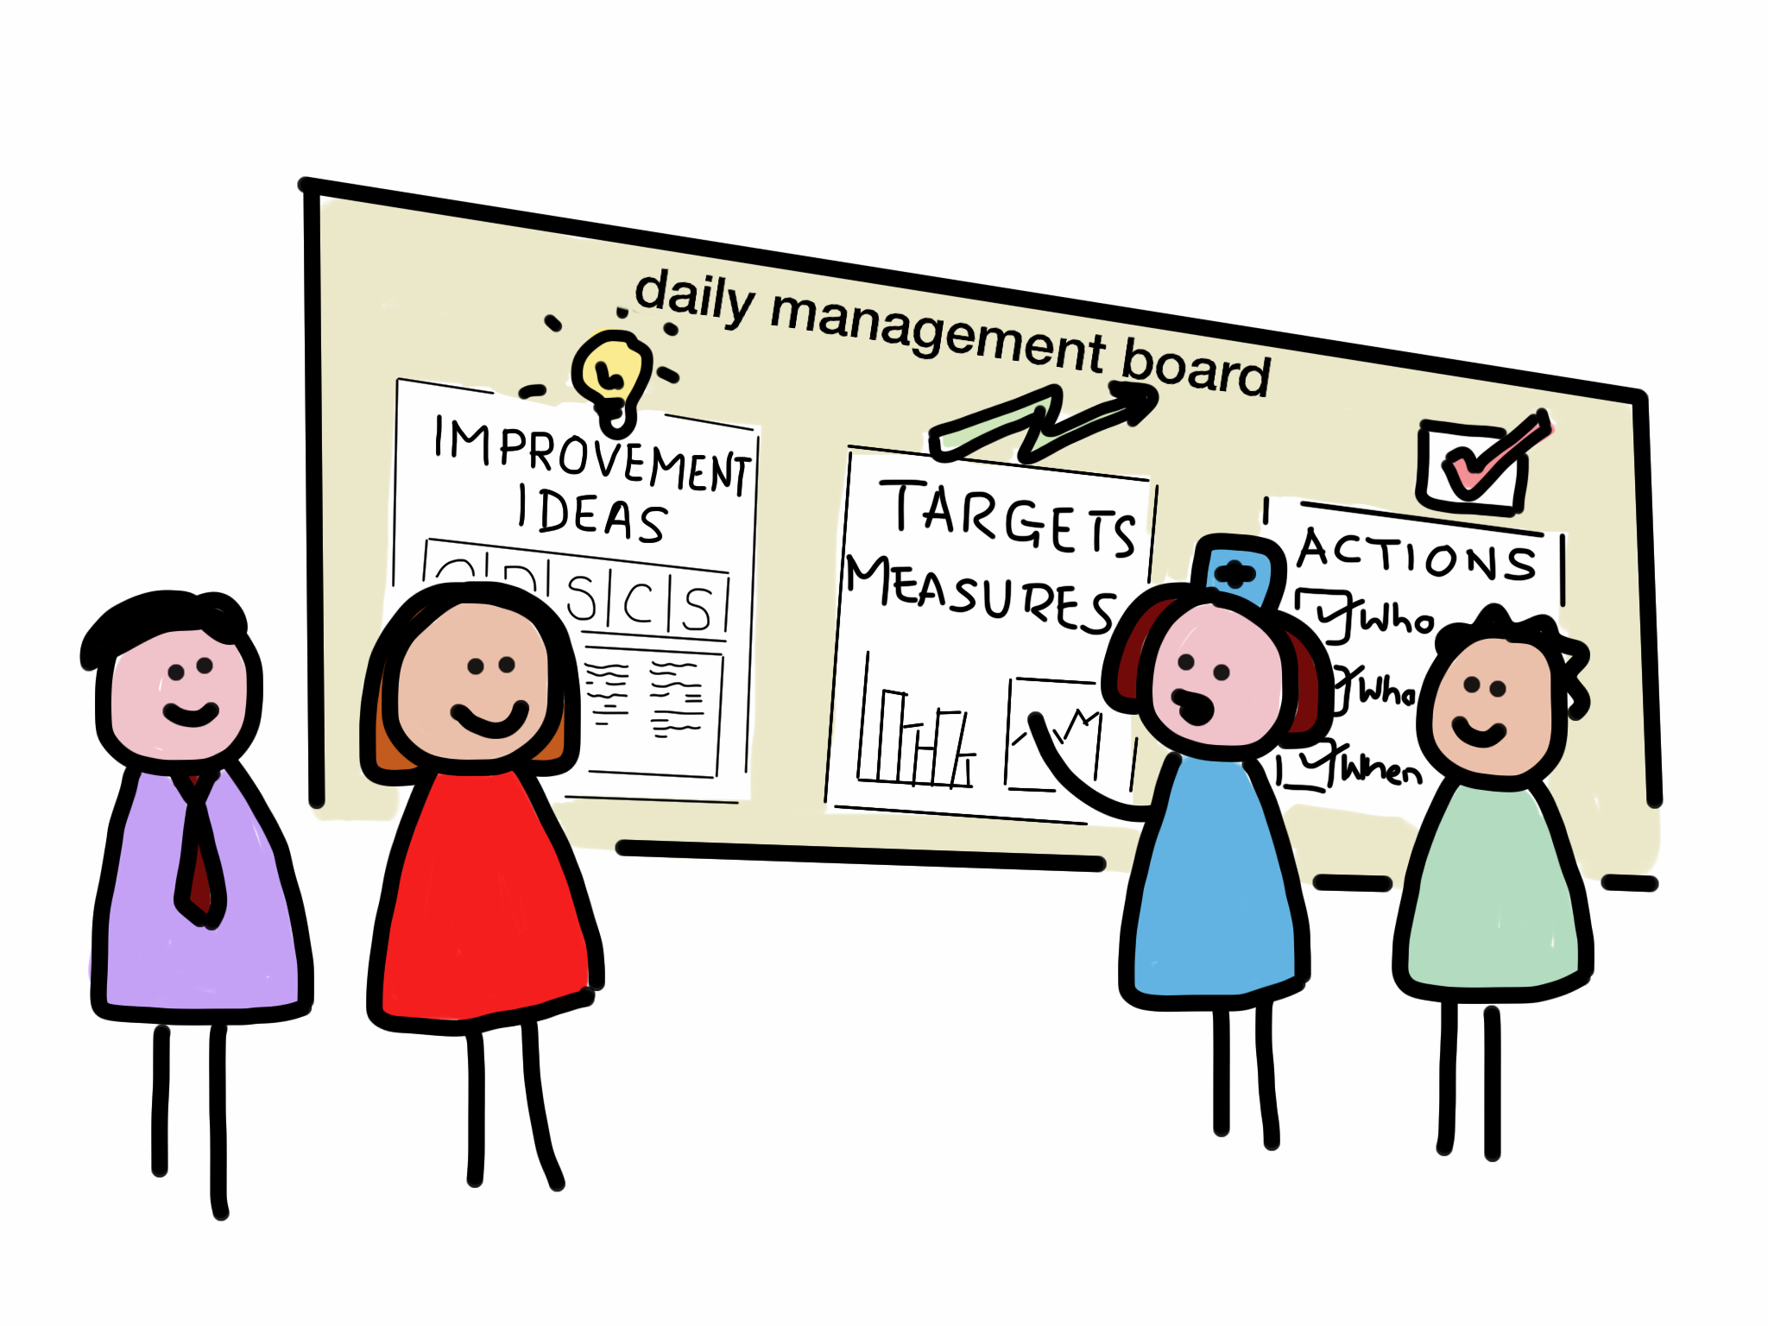





PROBLEM STATEMENT:

Slide 3
OPPORTUNITY

Slide 4
APPROACH

Slide 5
RESULTS

Slide 6
Next steps

